Slide 1
Introduction to SMS, MMS, Modems & Gateways
By Michael Wakahe, June 2010

Slide 2
SMS & SIM
Development of international SMS and SIM standards and interoperable application platforms for SIM and SMS Toolkit and Interpreter have been standardized for SIM and USIM by ETSI & 3GPP.
They are solution based standards.

Slide 3
SMS & SIM
SIM means “Subscriber Identity Module”
Its original purpose (and continuing role) was to identify a particular mobile user to the network in a secure and consistent manner.
To accomplish this, the SIM stores a private digital key that is unique to each subscriber and known only to the wireless carrier.
The key is used to encrypt the traffic to and from the handset.

Slide 4
SMS & SIM
The SIM is a smart chip that was designed as a secure, tamper-resistant environment for the cryptographic keys that GSM carriers use to:
  authenticate individual subscribers to the network connection and
  track those subscribers’ activities once they are on the air

Slide 5
SMS & SIM
The SIM is owned and controlled by network operator.
It sports an API and can host multiple applications.
A SIM is a just a smart card that happens to have a mobile phone as its reader.

Slide 6
SMS & SIM
From its first use in a GSM phone until very recently, a SIM was an 8-bit microcontroller, usually an Intel 8051 or a Motorola 6805.
The amount of memory in the SIM has grown. Initially containing only 256 bytes of RAM and 3 kilobytes of EEPROM, it has grown to 1,024 bytes of RAM and 32 kilobytes of EEPROM (2002)

Slide 7
SMS & SIM
All the software for the SIM - the operating system and the code that handles the file system and the APDUs - is burned into 32 to 64 kilobytes of ROM.
The 80 odd data files are kept in the EEPROM, and the RAM is used as an I/O buffer for communication with the handset.

Slide 8
SMS & SIM
This is about all that is needed for the SIM to perform its cryptographic duties
Also provide some relatively trivial telephony services such as storing a phone book of frequently dialled numbers.

Slide 9
SMS & SIM
Beginning in mid-1990s, as new applications started to find their way onto the mobile telephone, SIM started to morph into a full fledged application platform.
This put all kinds of evolutionary pressure on the SIM operating software and the SIM hardware.

Slide 10
SMS & SIM
The software started to sprout virtual machines, principally the Java virtual machine, to host non telephony applications,
The hardware started to grow additional memory and computational abilities.
Roughly speaking, there have been three generations of SIMs.

Slide 11
SMS & SIM
Generation | Name | Characteristic
1 | Purpose-built SIM | SIM performs network authentication and universal telephony services such as phone book and SMS message storage
2 | SIM with applications | Additional customer-specific services can be added as SIM Toolkit (STK) applications after the SIM is in the field
3 | SIM as an application | SIM is one of the multiple telephony applications, specifically the authentication application, on the platform

Slide 12
SMS & SIM
SIM maintains a constant connection to the network as long as the mobile device remains on.
The only way to ensure that the SIM can accomplish its handoff of subscribers from one network to another without interrupting communication is to base all of its functions on very detailed international standards.

Slide 13
SMS & SIM
Every GSM equipment manufacturer and carrier adheres to these standards, which cover everything including:
  physical size
  characteristics of the chip
  the way it handles and stores incoming information.

Slide 14
SMS & SIM
Because smart cards were designed to be extremely difficult to crack under a variety of attacks, the smart card’s core electronics and design architecture were adopted as the base of the SIM.
Building applications for the SIM has a lot in common with designing smart card applications

Slide 15
SMS & SIM
Typically there is a testing and certification process required for any application that is not developed directly by the network providers or SIM vendors.

Slide 16
SMS & SIM
The SIM Application Toolkit (SAT), defined in [3GPP-
31.111], defines mechanisms for allowing SIM-hosted
applications to interact with the mobile equipment. This
includes:
Profile download: this mechanism allows the mobile equipment to inform the SIM about its capabilities.
Proactive SIM: a proactive SIM can issue commands to the mobile equipment.
Data download to SIM

Slide 17
SMS & SIM
Menu selection: this mechanism allows the (U)SIM to define menu items and to be notified by the mobile equipment when the subscriber has selected one of the menu items.
Call control by SIM: here the SIM performs a control prior to the establishment of calls by the mobile equipment. This allows the SIM to authorize or reject the call establishment or to modify the parameters of the call to be established.
Control of outgoing messages by SIM: with this mechanism, the SIM performs a control prior to the sending of messages by the mobile equipment. This allows the SIM to authorize or reject the sending of a message.

Slide 18
SMS & SIM
Event download: allows the SIM to provide a set of events to be monitored by the mobile equipment. If an event occurs then the mobile equipment notifies the SIM.
Security: this mechanism ensures data confidentiality, data integrity and data sender validation.
Timer expiration: the SIM can manage a set of timers running physically in the mobile equipment.
Bearer independent protocol: enables SIM to establish a data connection between SIM and mobile equipment and between mobile equipment and a remote server.

Slide 19
SMS & SIM
3 primary drawbacks with downloaded applications are:
  Occupy precious space in the EEPROM of the SIM
  Hard to manage. Network operator has to check that they are clean, process of downloading onto SIM has to be airtight
  Human interface. No matter whose application it is, the subscriber can’t figure out how to use it will call their network operator implying call training & call centre expenses

Slide 20
SMS & SIM
In 1998, Across Wireless (now Sonera SmartTrust) came up with a solution to these problems that still harnessed the full capability of the SIM.
They installed a microbrowser on the SIM that could interpret downloaded mark-up language pages.

Slide 21
SMS & SIM
With microbrowser:
Downloaded pages were thrown away after they were interpreted so that they didn’t burn up EEPROM space.
Mark-up languages were much simpler than procedural languages so they could be checked automatically for deviant behaviour.
Publication of a style manual and quick manual checks when the application was certified could standardize and homogenize the human interface and minimize number of calls to customer service.

Slide 22
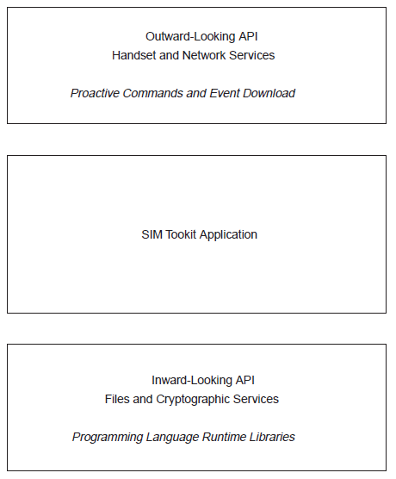
SMS & SIM
Figure: Inward and outward APIs for SIM applications.

Slide 23
SMS & SIM
The SIM microbrowser is a byte-code interpreter that allows the SIM to:
  download, display, interact with the subscriber,
  and communicate with your application with a Web-based set of instructions
  and then throw away the instructions once the interaction has been completed.

Slide 24
SMS & SIM
This “fire-and-forget” model of user interaction fits very well with constraints and capabilities of the SIM.
As a result, many network operators favour SIM microbrowser as a more lightweight and easily controlled way to get value-added applications to their customers than the more difficult & administratively expensive executable program model.

Slide 25
SMS & SIM
The second, less widely used, model of computation is where you install your application code directly on the SIM just as you might install a new program on your PC.
Building an executable program for the SIM is much more complex than simply sending pages to a program already installed on the SIM, as with the microbrowser.

Slide 26
SMS & SIM
Whether you are building a microbrowser application or an executable program application, your code is written against an API inside that SIM.
This interface is described by ETSI TS 102.223 — Smart cards; card application toolkit

Slide 27
SMS & SIM
As shown in the figure, a SIM application has to deal with two APIs.
The inward-looking one provides a standard, small, OS services to the application such as file reading and writing and computational functions.
The outward-looking one connects the SIM application to the human interface capabilities of the handset and to the network.

Slide 28
SMS & SIM
Two types of information flow between your SIM application and the outside world.
Only difference is who initiates the conversation.
If SIM initiates the conversation, flow is called a “proactive command”; your application is asking the handset to do something.
If handset initiates the conversation, flow is called an “event download”; the handset is the application that made something happen

Slide 29
SMS & SIM
As of late 2001, there are 31 proactive commands on the SAT API.
These include: DISPLAY TEXT, GET INKEY, GET INPUT, MORE TIME, PLAY TONE, POLL INTERVAL, REFRESH, SET UP MENU, RECEIVE DATA, SEND DATA, SEND USSD, SET UP CALL, RUN AT COMMAND

Slide 30
SMS & SIM
As more SIMs capable of running virtual machines such as Java come to market, you can also develop applications that can be downloaded over the air — as long as the application is acceptable to the wireless carrier.

Slide 31
SMS & SIM
SMS = Short Message Service
According to the GSM Association, “Each short message is:
  up to 160 characters in length when Latin alphabets are used,
  and 70 characters in length when non-Latin alphabets such as Arabic and Chinese are used.

Slide 32
SMS & SIM
Short messages can be encoded using a variety of alphabets:
  the default GSM 7-bit alphabet
  the 8-bit data alphabet
  16-bit UTF-16 alphabet

Slide 33
SMS & SIM
Characters in languages such as Arabic, Chinese, Korean, Japanese or Cyrillic alphabet languages must be encoded using the 16-bit UTF-16 character encoding

Slide 34
SMS & SIM
Depending on which alphabet the subscriber has configured in the handset, this leads to the maximum individual Short Message sizes of:
  160 7-bit characters,
  140 8-bit characters,
  or 70 16-bit characters (including spaces).

Slide 35
SMS & SIM
An SMS message nearly always gets through.
If mobile phone isn’t on when you send a message, the system holds it until the phone is turned on and then delivers it.
The system also can generate a return receipt that tells you that the message has been delivered.

Slide 36
SMS & SIM
SMS messages are encrypted, so there is no fear that your message will be snatched out of the air and read.
You can also add your own encryption to an SMS message so that not even the phone company can read what you are sending.

Slide 37
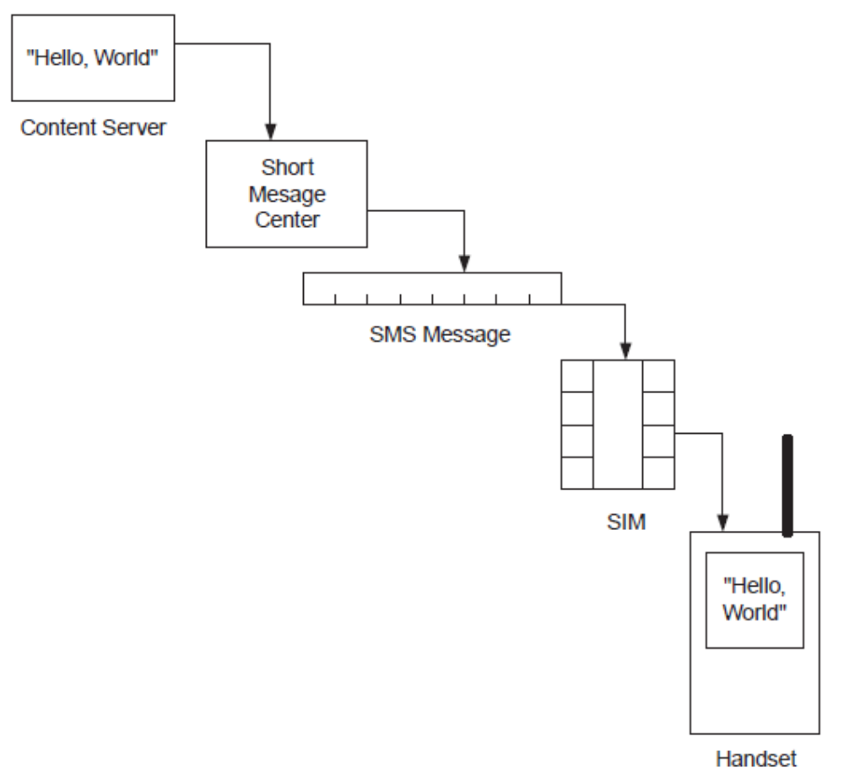
SMS & SIM
Figure: Message flow from server to screen.

Slide 38
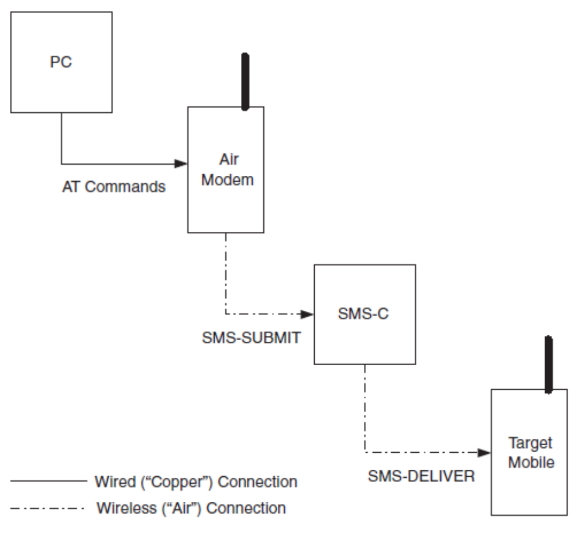
SMS & SIM
Figure: Message flow from desktop PC to mobile handset.

Slide 39
SMS & SIM
The SMS protocol stack is composed of four layers:
  the application layer,
  the transfer layer,
  the relay layer
  the link layer.

Slide 40
SMS & SIM
SMS-based applications are directly based on the transfer layer.
If you are willing to develop applications, for which SMS is a building block, needs to master the transfer layer.

Slide 41
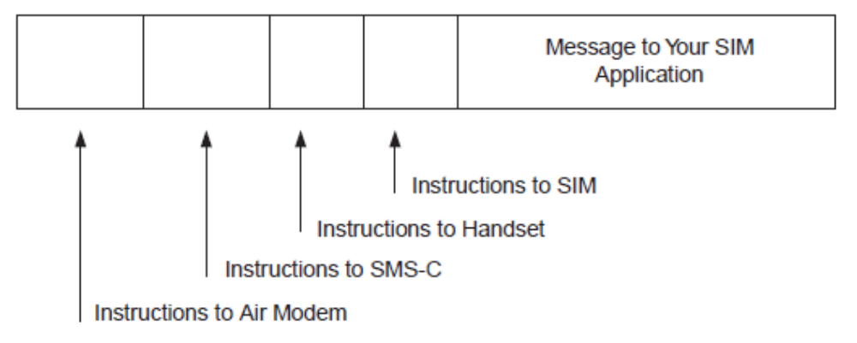
SMS & SIM
Figure: SMS message headers.

Slide 42
SMS & SIM
There are six kinds of messages that flow in the SMS network at the transfer layer
  SMS-SUBMIT “submits” a message to the SMSC, generally for forward transmission to another mobile device
  SMS-COMMAND goes to the SMSC and tells it to do something

Slide 43
SMS & SIM
Four of the six messages go from the network to the mobile device.
Of these, only one carries a message from another mobile device:
  SMS-DELIVER delivers a message from another mobile

Slide 44
SMS & SIM
The other three messages are generated by the network itself and tell the mobile what is going on.
  SMS-SUBMIT-REPORT reports on the results of an SMS-SUBMIT or an SMS-COMMAND
  SMS-DELIVER-REPORT reports on the success or failure of the delivery of an SMS-DELIVER or SMS-STATUS-REPORT message
  SMS-STATUS-REPORT reports on the results of an SMS-COMMAND message

Slide 45
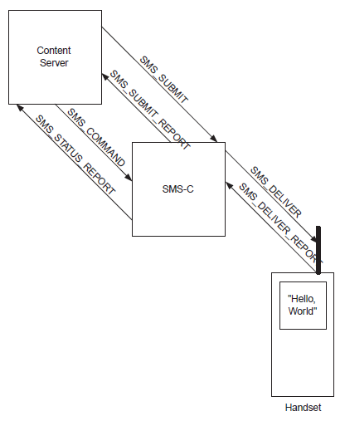
SMS & SIM
Figure: The six message types in SMS message traffic.

Slide 46
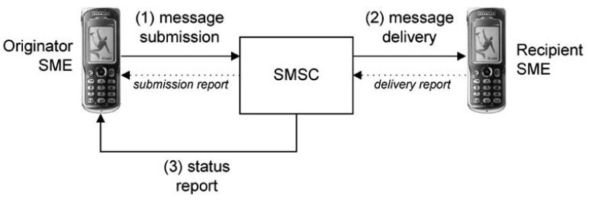
SMS & SIM
Figure: Message transfer between two SMEs

Slide 47
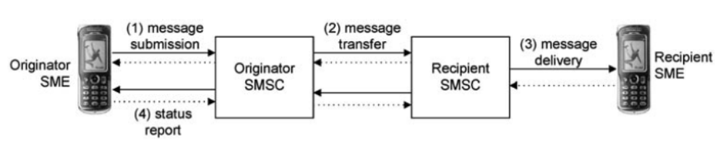
SMS & SIM
Figure: Message transfer

Slide 48
SMS & SIM
The sounds and pictures that accompany SMS messages should not be confused with ringtones, operator logos, wake-up logos, group graphics and other such features that personalize the handset.

Slide 49
SMS & SIM
These features usually are delivered to and installed on your phone using SMS
But they are embedded in special SMS messages that are handled by the handset
These handset personalization sound and graphic features also tend to be proprietary to particular handsets and particular network operators

Slide 50
SMS & SIM
Many GSM operators offer direct connections to the short message centers. These can be dial-up, X.25, or Internet connections.
Many different protocols are used on these connections, and the majority of these are proprietary to the company that sold the SMSC to the operator.

Slide 51
SMS & SIM
Examples of these protocols are:
  SMSC Vendor SMSC Connection Protocol
  ADC NewNet SMCI (Short Message Client Interface)
  CMG UCP (Universal Computer Protocol)
  CMG EMI (External Machine Interface)
  Comverse ISMSC (Intelligent Short Message Service Center)
  Ericsson CAP II (Computer Access Protocol #2)
  Logica SMPP (Short Message Peer to Peer)
  Motorola CDMP (Cellular Digital Messaging Protocol)
  Nokia CIMD (Computer Interface to Message Distribution)
  SEMA OIS (Open Interface Specification)
  SEMA SMS2000

Slide 52
SMS & SIM
Quite unlike SMS, which was not initially envisioned to be a major source of income, the SIM was developed explicitly to enable network operators to create new revenue streams.
However, unlike SMS, it has taken a long time to generate widespread availability of SIM based applications.
Nonetheless, all of the necessary building blocks are in place.

Slide 53
SMS & SIM
Consumer Applications based on SMS:
  Person-to-person Messaging
  Information Services
  Voice Message and Fax Notifications
  Internet Email Alerts
  Download Services
  Chat Applications
  Smart Messaging

Slide 54
SMS & SIM
Corporate Applications based on SMS:
  Vehicle Positioning
  Remote Monitoring

Slide 55
SMS & SIM
Operator Applications Based on SMS
  SIM Lock
  SIM Updates
  Message Waiting Indicator
  WAP Push

Slide 56
MMS
MMS allows the exchange of multimedia messages in the context of person-to person and machine-to-person scenarios.
This includes the possibility of composing multimedia messages as ‘slideshow’ presentations (i.e. combination of text, audio and pictures, all choreographed over time).

Slide 57
MMS
With MMS, a subscriber is able to compose a message and send it to Internet mail recipients.
In addition, the MMS subscriber can retrieve message originating from Internet users.

Slide 58
MMS
The setting of the Multimedia Messaging Service is more complex than SMS and the definition of MMS
Has required a tremendous workload from several standardization development organizations.

Slide 59
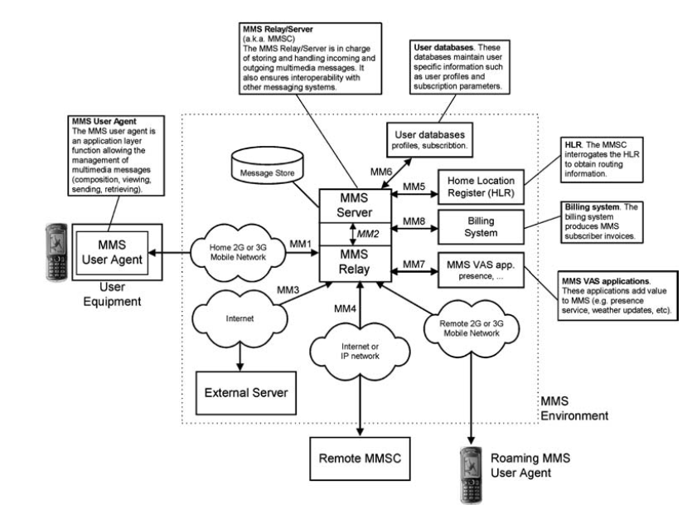
MMS

Slide 60
MMS
In an MMS environment, network elements communicate via a set of interfaces.
Each interface supports a number of operations such as message submission, message retrieval, message forwarding.
Several interfaces have been standardized in order to ensure interoperability between devices produced by various manufacturers.
Other interfaces have not been standardized and are therefore the subject of proprietary implementations.

Slide 61
MMS
In comparison with SMS and EMS, MMS has the following
advantages:
Multimedia messages can contain a wide range of content formats such as colour images/animations, video, etc. Additionally, messages can be organized as compact multimedia slideshows.
Interoperability between MMS and the Email service has been significantly improved.
MMS is well integrated with innovative devices/services such as camera accessories, remote photo albums.
MMS is a future-proof technology and will be the subject of many evolutions in the near future.

Slide 62
MMS
It has the following drawbacks:
MMS is a very recent service and MMS-capable devices (handsets and MMSCs) are not yet widely available. This prevents global introduction of MMS for all market segments.
Unlike EMS, MMS requires several network infrastructure extensions in order to operate properly (e.g. MMSC, additional WAP gateway).

